Slide 1

Corona Virus Analysis with SQL
Mentorness
INTERNSHIP PORECT
BY
MIHIR PATEL

Slide 2
Table of contents
Project Overview
Analysis
01
03
Dataset Description
Summary
02
04

Slide 3
01
Project Overview

Slide 4

Introduction to the disease
1. The CORONA VIRUS pandemic has had a significant impact on public health and has created an urgent need for data-driven insights to understand the spread of the virus. 2. As a data analyst, you have been tasked with analyzing a CORONA VIRUS dataset to derive meaningful insights and present your findings.

Slide 5
02
Dataset Description

Slide 6
Information
Province | Geographic subdivision within a country/region.
Country/Region | Geographic entity where data is recorded.
Latitude | North-south position on Earth's surface.
Longitude | East-west position on Earth's surface.
Date | Recorded date of CORONA VIRUS data.
Confirmed | Number of diagnosed CORONA VIRUS cases.
Deaths | Number of CORONA VIRUS related deaths.
Recovered | Number of recovered CORONA VIRUS cases.

Slide 7
03
Analysis

Slide 8
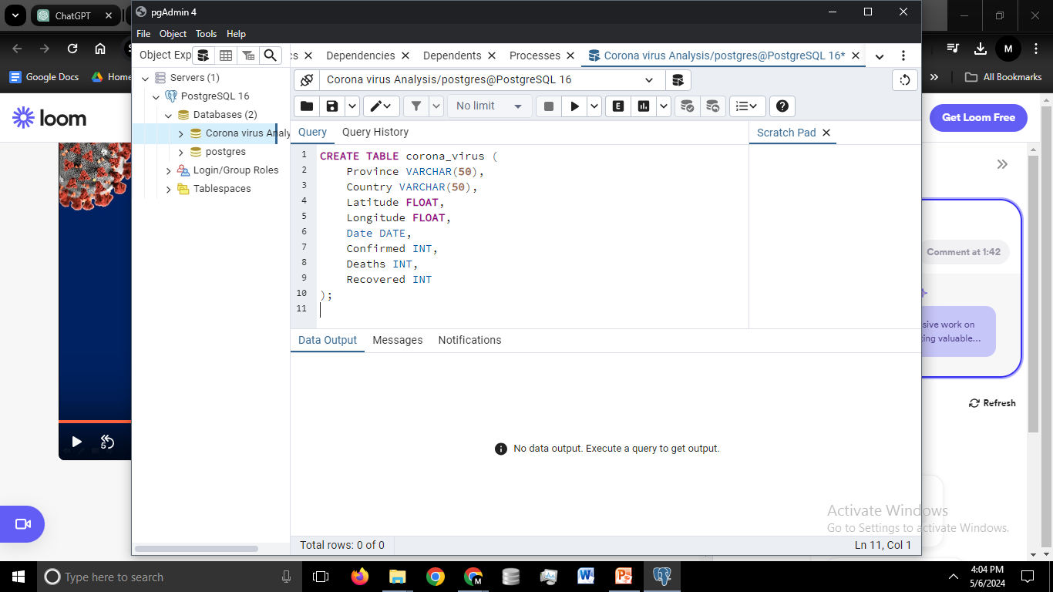
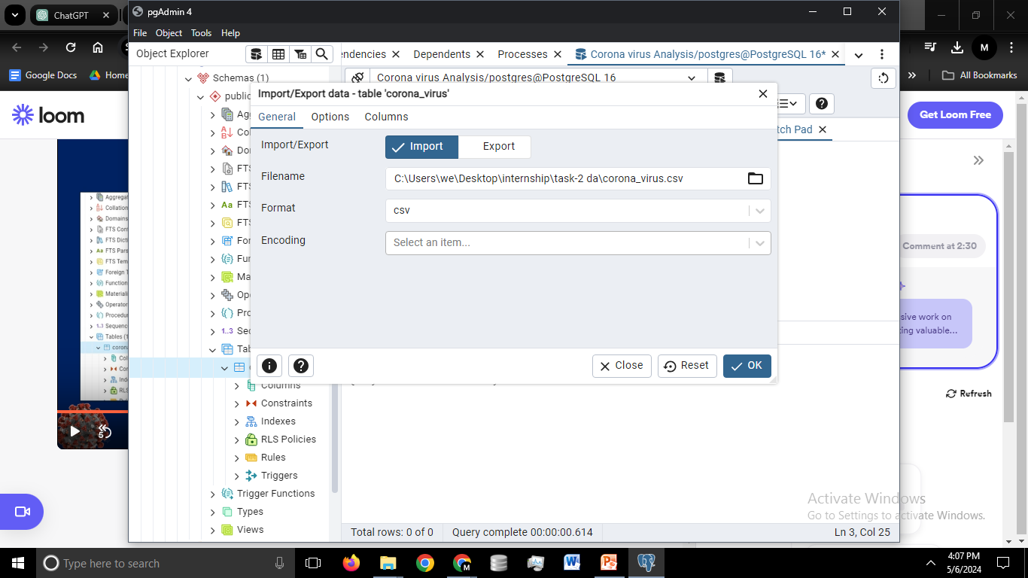
Import data into the table

Slide 9
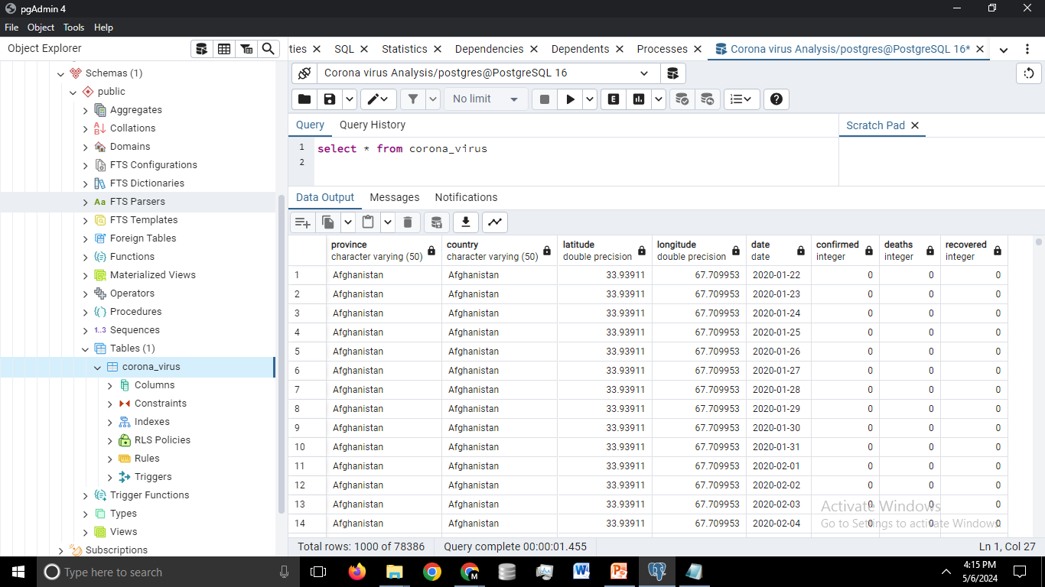

Slide 10
Queries
1 | Write a code to check NULL values.
2 | If NULL values are present, update them with zeros for all columns.
3 | check total number of rows
4 | Check what is start_date and end_date
5 | Number of month present in dataset
6 | Find monthly average for confirmed, deaths, recovered
7 | Find most frequent value for confirmed, deaths, recovered each month
8 | Find minimum values for confirmed, deaths, recovered per year
9 | Find maximum values of confirmed, deaths, recovered per year
10 | The total number of case of confirmed, deaths, recovered each month
11 | Check how corona virus spread out with respect to confirmed case -- (Eg.: total confirmed cases, their average, variance & STDEV )
12 | Check how corona virus spread out with respect to death case per month -- (Eg.: total confirmed cases, their average, variance & STDEV )

Slide 11
Queries
13 | Check how corona virus spread out with respect to recovered case -- (Eg.: total confirmed cases, their average, variance & STDEV )
14 | Find Country having highest number of the Confirmed case
15 | Find Country having lowest number of the death case
16 | Find top 5 countries having highest recovered case

Slide 12
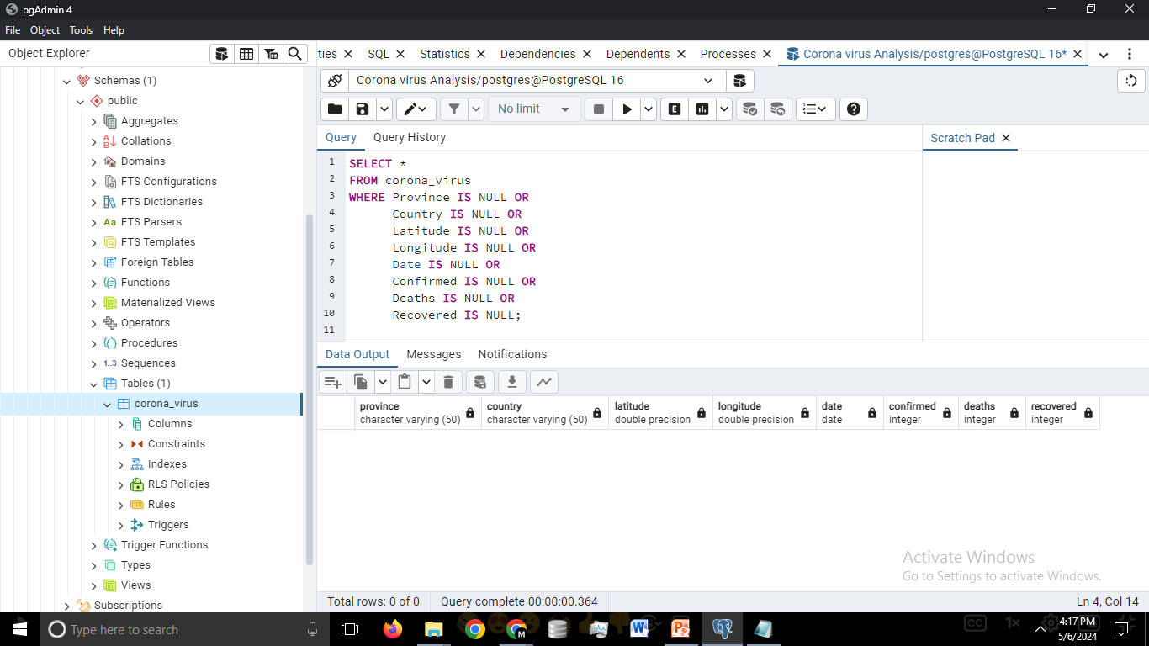
Q 1- Write a code to check NULL values

Slide 13
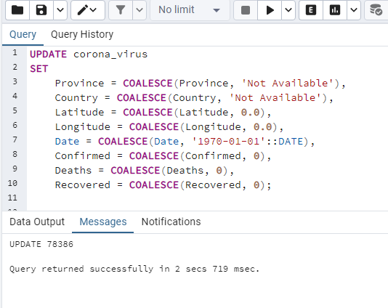
Q 2- If NULL values are present, update them with zeros for all columns.

Slide 14
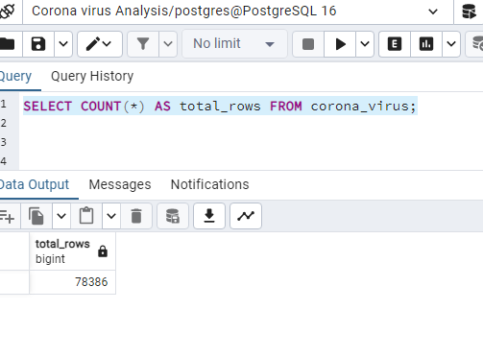
Q 3 - check total number of rows

Slide 15
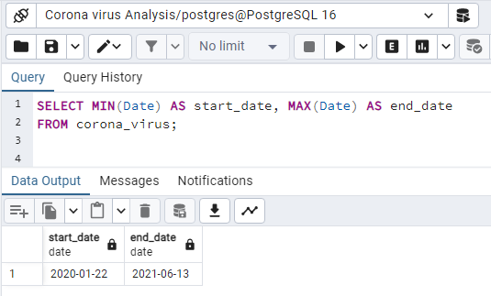
Q 4- Check what is start_date and end_date

Slide 16
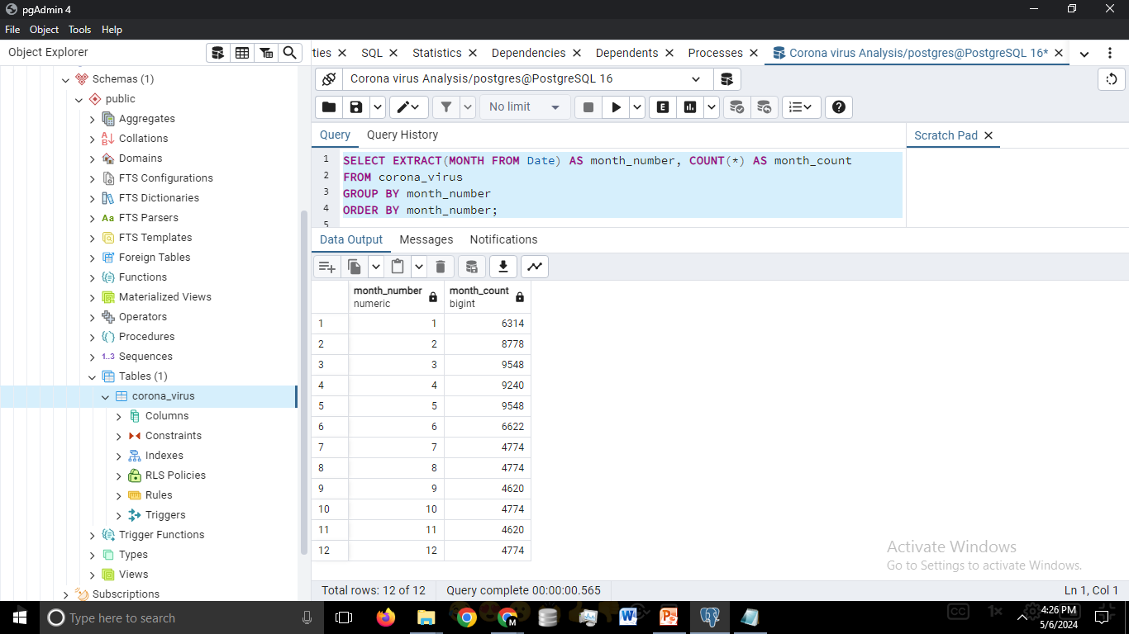
Q 5- Number of month present in dataset

Slide 17
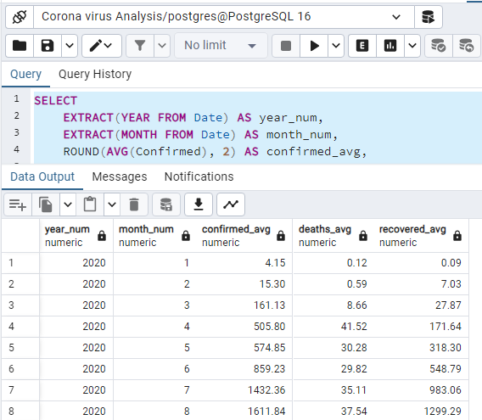
Q 6- Find monthly average for confirmed, deaths, recovered

Slide 18
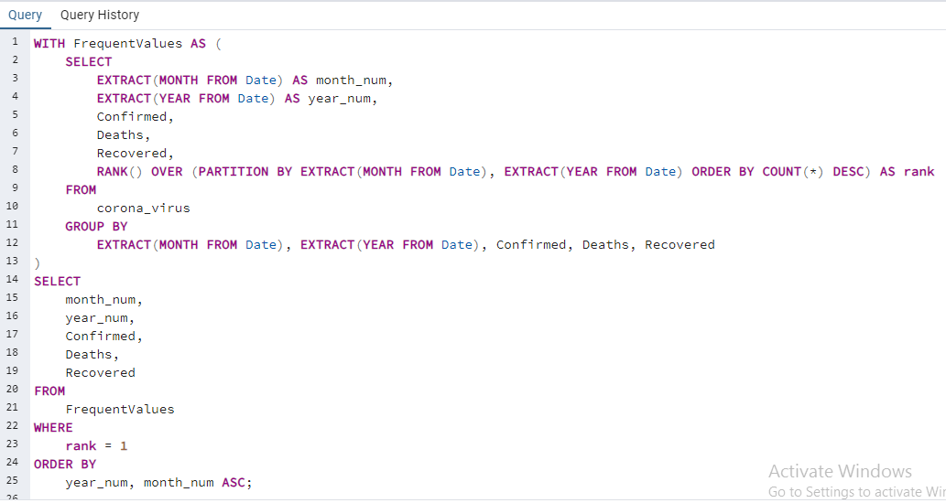
Q 7- Find most frequent value for confirmed, deaths, recovered each month

Slide 19
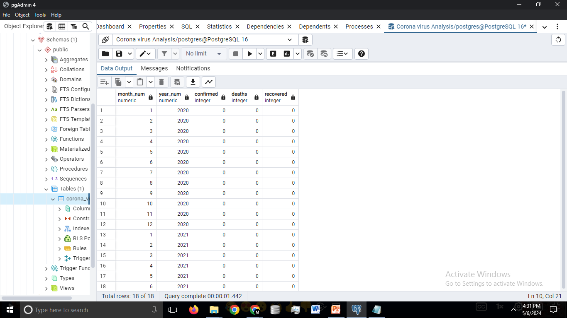
Q 7- Find most frequent value for confirmed, deaths, recovered each month (output)

Slide 20
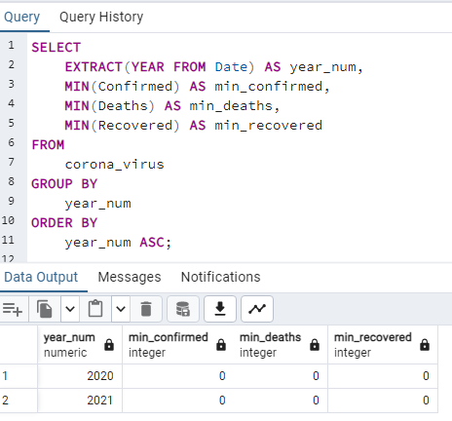
Q 8 -Find minimum values for confirmed, deaths, recovered per year

Slide 21
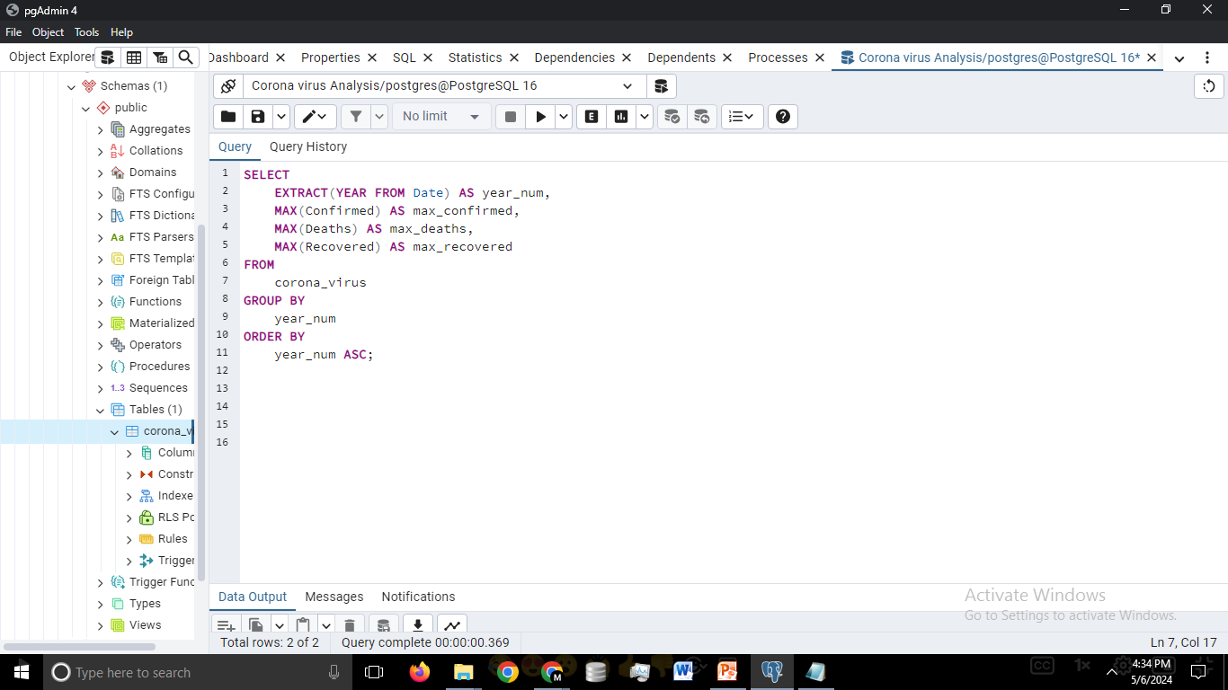
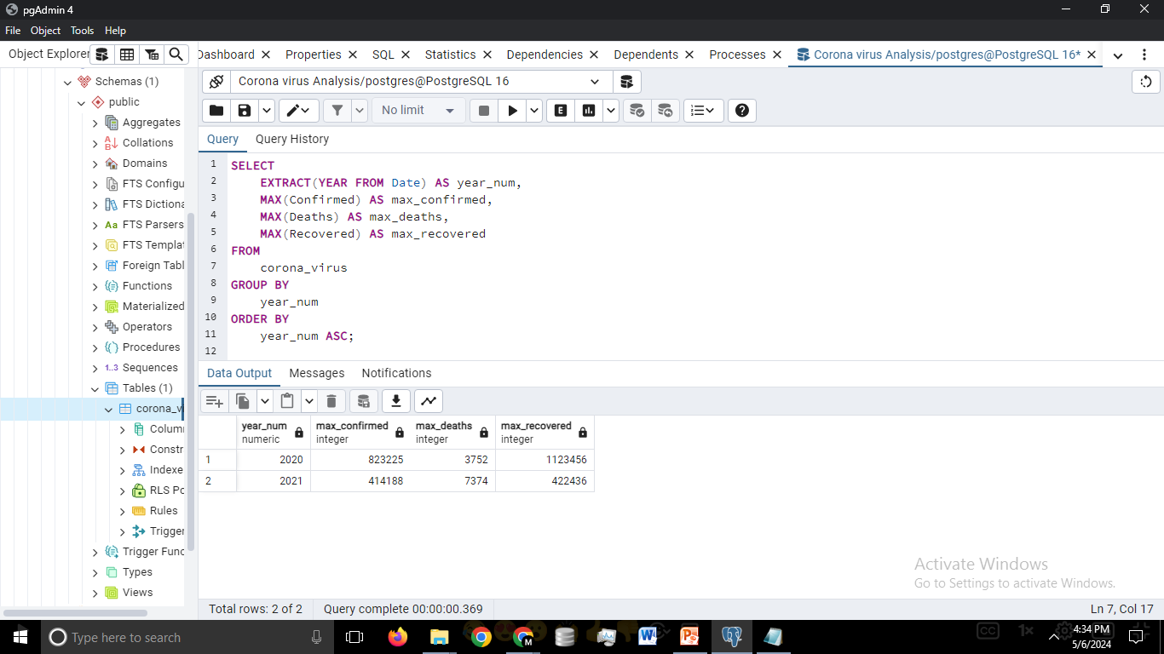
Q 9 -Find maximum values of confirmed, deaths, recovered per year

Slide 22
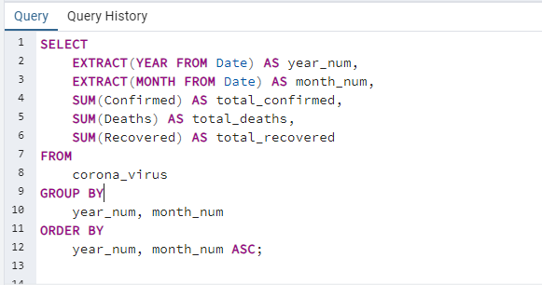
Q 10-The total number of case of confirmed, deaths, recovered each month

Slide 23
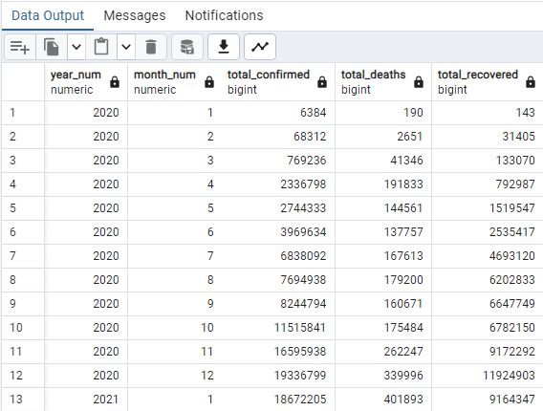
Q 10 -The total number of case of confirmed, deaths, recovered each month (output)

Slide 24
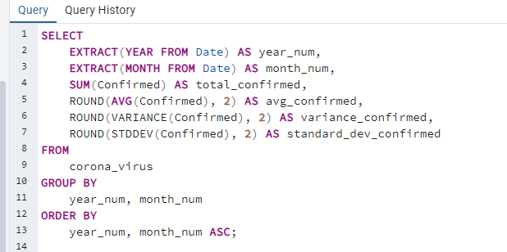
Q 11 - Check how corona virus spread out with respect to confirmed case -- (Eg.: total confirmed cases, their average, variance & STDEV )

Slide 25
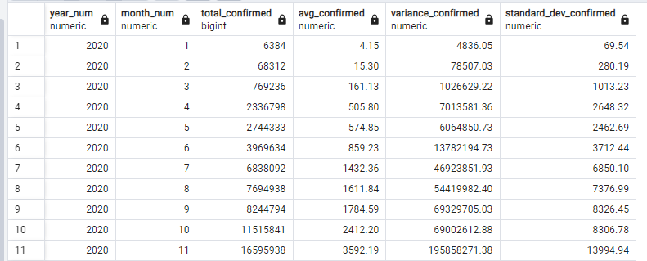
Q 11 - Check how corona virus spread out with respect to confirmed case -- (Eg.: total confirmed cases, their average, variance & STDEV ) (output)

Slide 26
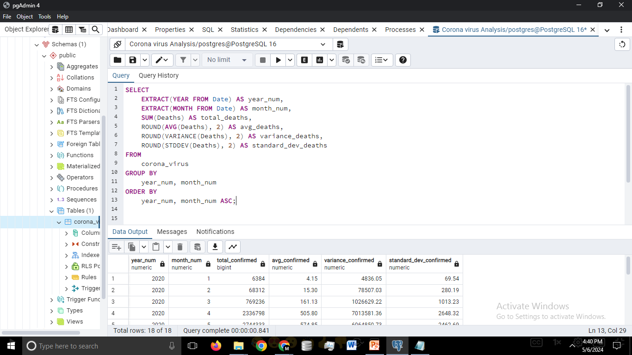
Q 12- Check how corona virus spread out with respect to death case per month -- (Eg.: total confirmed cases, their average, variance & STDEV )

Slide 27
Q 12- Check how corona virus spread out with respect to death case per month -- (Eg.: total confirmed cases, their average, variance & STDEV ) (output)

Slide 28
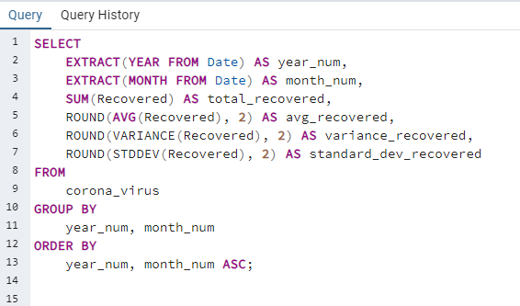
Q 13 - Check how corona virus spread out with respect to recovered case -- (Eg.: total confirmed cases, their average, variance & STDEV )

Slide 29
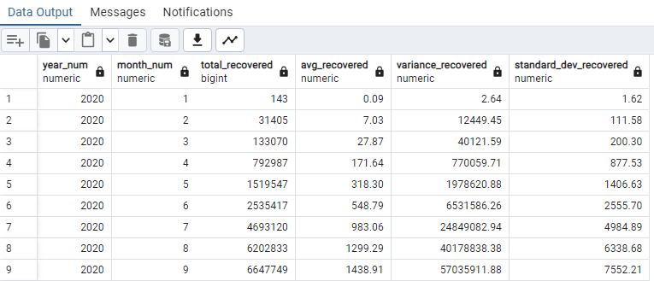
Q 13 - Check how corona virus spread out with respect to recovered case -- (Eg.: total confirmed cases, their average, variance & STDEV ) (output)

Slide 30
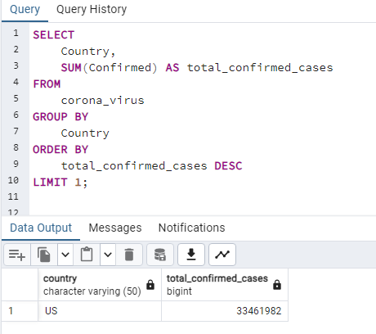
Q 14 - Find Country having highest number of the Confirmed case

Slide 31
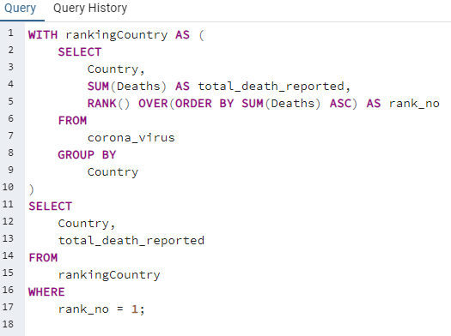
Q 15 - Find Country having lowest number of the death case

Slide 32
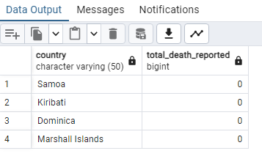
Q 15 - Find Country having lowest number of the death case (output)

Slide 33
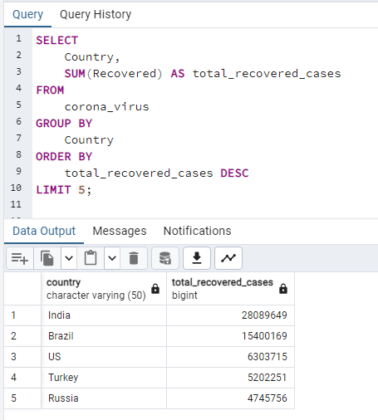
Q 16 - Find top 5 countries having highest recovered case

Slide 34
04
SUMMARY

Slide 35
Total Confirmed Cases by Country:
The analysis revealed the total confirmed cases of coronavirus by country.
It highlighted the countries with the highest number of confirmed cases, providing insights into the severity of the pandemic across different regions.
Total Deaths Reported by Country:
The analysis identified the total number of reported deaths due to coronavirus by country.
It ranked countries based on the number of deaths reported, shedding light on the impact of the virus on different populations.
Total Recovered Cases by Country:
The analysis showcased the total number of recovered cases of coronavirus by country.
It outlined the countries with the highest number of recovered cases, indicating the effectiveness of healthcare systems and recovery efforts.
Monthly Analysis of Coronavirus Cases:
The analysis examined the trend of coronavirus cases over time, categorizing them into monthly intervals.
It provided insights into the progression of the pandemic, highlighting periods of peak and decline in case numbers.

Slide 36
Thanks!

